Slide 1

Column in CSV | General Terminology | Description
A | S.No
B | Date | Date of Transaction
C | YearAcademic | Academic year under which transaction has taken place
D | Session | Session under which transaction has taken place
E | Alloted Category | Not Considerable
F | Voucher Type | Entry Mode Name
G | Voucher Number | A voucher number that is generated against every entry mode
H | Roll Number | Student Roll Number
I | Admno | Student Admission Number
J | Status | Student status (Regular/Withdrawn etc.)
K | Fee Category | General/NON SAARC NRI/SAARC NRI – depending on feecategory of the student, the fees amount varies
L | Faculty | Ex:School of Engineering (branches)
Column in CSV | General Terminology | Description
M | Program | Programs offered by Faculty Ex: B.Tech, M.Tech etc.
N | Department | Departments under a specific Program of School Ex: IT, CSE, EEE, ECE etc.
O | Batch | Group of students in a specific class Ex: B.Tech in CSE 2017-18 IV Sem VIII
P | Receipt Number | Receipt number is generated for every transaction
Q | Fee Head | Types of fees that student pays (fee types – exam fee, tuition fees etc.)
R to Z | Due Amount, Paid Amount, Concession Amount, Scholarship Amount, Reverse Concession Amount, Writeoff Amount, Adjusted Amount | These are different amounts that will be stored in DB tables (financial trans and common fee collection)

Slide 2
S.No. | DB Table Name | Column in CSV | Description
1 | Temporary_completedata |  | All the data(884950) in .csv file has to be stored in this DB Table once you import the data through import routine
2 | Branches | L (Faculty Column in CSV) | 24 Unique Branches from CSV
3 | Feecategory | K | 3 Fee Categories Map each fee category with all the branches - (3 x 24)
4 | Feecollectiontypes (STATIC TABLE) |  | 6 Types (1. academic, 2. academicmisc, 3. hostel, 4. hostelmisc, 5. transport, 6. transportmisc) Map each fee type with all the branches - (6 x 24)
5 | Feetypes | Q (Fee Head Column in CSV) | 49 Feeheads (49 Unique Fee Heads from CSV) Map each fee head with all the branches (49 x 24) map with
6 | Entrymode (STATIC TABLE) (REFER SLIDE 6) | F | 12 Entry Modes
7 | Module (STATIC TABLE) (REFER SLIDE 6) |  | 6 Modules academic, academicmisc, hostel,hostelmisc, transport,transportmisc
FOR FURTHER 4 TABLES REFER NEXT SLIDE NO. 4

Slide 3
S.No. | DB Table Name | Column in CSV | Description
8 | Financialtran (Parent) (REFER SLIDE 8) |  | Total Amount w.r.to DueAmount, Writeoff, Scholarship, Reverseconcession, concession will be stored
9 | Financialtrandetail (Child) (REFER SLIDE 8) |  | Total Amount in Financialtran (Parent) Table is stored w.r.to head wise
10 | Commonfeecollection (Parent) (REFER SLIDE 9) |  | Total Amount w.r.to Paidamount, Adjustable Amount, Refund amount, Fundtransfer
11 | Commonfeecollectionheadwise (Child) (REFER SLIDE 9) |  | Total Amount in Commonfeecollection (Parent) is stored w.r.to head wise

Slide 4









DB Table 1: Branches
Id | Branch name
1 | School of Engineering
DB Table 2: FeeCategory
DB Table 3 : feecollectiontype
Id | Fee_category | Br_id
1 | General | 1
Id | Collection_head | Collection -desc | Br_id
1 | Academic | Academic | 1
DB Table 4 : feetypes
id | Fee_category | F_name | Collection_id | Br_id | Seq_id | Fee_type_ledger | Fee_headtype
1 | 1 | Tuition fee | 1 | 1 | 1 | Tuition fee | 1
2 | 1 | Exam fee | 1 | 1 | 2 | Exam fee | 1
3 | 1 | Hostel fee | 1 | 2 | 3 | Hostel Fee | 2
2. fee_category = id from feecategory table (Consider all fee category comes under general and all Fee_Category_id should be 1)
3. f_name = exam fee, tuition fee etc.from csv feehead column
4. Collection_id = id from feecollectiontype table (Consider all collection id comes under Academic and all Fee_collection_id should be 1)
5. br_id = id from branches table (br_id is branch id)
6. Seq_id is a number which is same for each fname irrespective of branch (ex: tution fee =1 where ever we have tuition fee it is 1 irrespective of branch)
7. Fee_type_ledger is same as fname
8. Fee_head_type = module id from module table (academic-1, academic misc -11, hostel-2 etc)

Slide 5
DB Table 5 : entrymode
DB Table 6 : Module
id | Entry_modename | crdr | entrymodeno
1 | DUE | D | 0
2 | REVDUE | C | 12
3 | SCHOLARSHIP | C | 15
4 | SCHOLARSHIPREV/REVCONCESSION | D | 16
5 | CONCESSION | C | 15
6 | RCPT | C | 0
7 | REVRCPT | D | 0
8 | JV | C | 14
9 | REVJV | D | 14
10 | PMT | D | 1
11 | REVPMT | C | 1
12 | Fundtransfer | + ve and -ve | 1
Module Name | Module id
academic | 1
academicmisc | 11
hostel | 2
hostelmisc | 22
transport | 3
transportmisc | 33
NOTE : ENTRY MODE & MODULE TABLES will remain static as provided

Slide 6
Stored in financial_trans DB Table
Stored in common_fee_collection DB Table
Entry Mode Name/ Vochure type (Column F) | crdr | entrymode
DUE | D | 0
REVDUE | C | 12
SCHOLARSHIP | C | 15
SCHOLARSHIPREV/REVCONCESSION | D | 16
CONCESSION | C | 15
RCPT | C | 0
REVRCPT | D | 0
JV | C | 14
REVJV | D | 14
PMT | D | 1
REVPMT | C | 1
Fundtransfer | + ve and -ve | 1
CSV Column | CSV (R-Z) | Adjusted Receipt id | Additional
R | Due Amount
W | Writeoff
U | Scholarship |  | Type of concession = 2
V | Reverse concession
T | Concession |  | Type of concession = 1
S | Paid amount
S | Paid amount
X | Adjusted amount
X | Adjusted amount
Y | Refund amount | NULL its in | NOT NULL reflects in
Y | Refund amount
Z | Fund transfer amount

Slide 7
Consider due,concession,scholarship,writeoff,revconcession/revscholarship)
DB Table 7 : Financial_trans (Parent Table)
Id | modul eid | transid | admno | amount | crd r | tranDate | acadYear | Entry mode | voucherno | brid | Type of concession
25202 6 | 1 | 73633 1 | 11CET BT101 146 | 138000.0 0 | D | 01-08-2011 | 2011- 2012 | 0 | 576499 | 1 | Either 1 or 2 based on entry
transid is unique random number for each transaction
Moduleid will get from module table.
Crdr & entry mode will get from entry mode table
Type of concession is 1 for concession and 2 for scholarship and for remaining all it is null
DB Table 8 : Financial_transdetail (Child Table)
headid is id of feetypes table
id | financialTranId | moduleId | amount | headId | crdr | brid | head_name
656280 | 252026 | 1 | 128000.00 | 1 | D | 1 | Tution Fee
656281 | 252026 | 1 | 10000.00 | 2 | D | 1 | Security Fee
DB Table: F
inancial_t
ran_d
etails (C
hild Table)

Slide 8
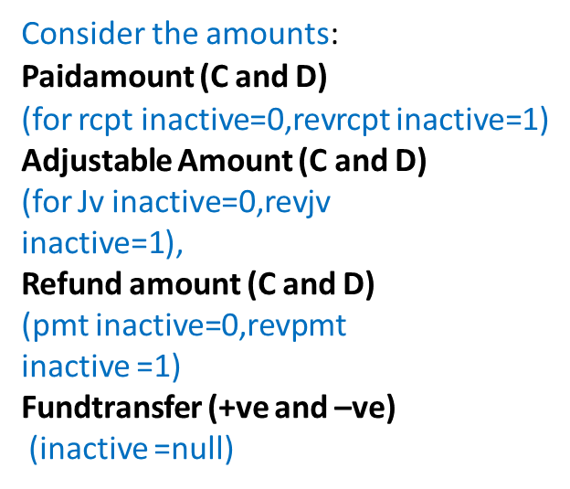
DB Table 9 : Common_fee_collection (Parent Table)
id | moduleId | transId | admno | rollno | amount | brId | acadamicYear | financialYear
534873 | 1 | 668214 | 20GCFC10300 09 | 3171T020C UGCFC101N 003 | 97000.00 | 1 | 2016-2017 | 2016-2017
displayReceiptNo | Entrymode | Paid Date | inactive
2020-2021/AIE/C13/2169 | 0 | 28-08-2020 | Either 0/1 based on entry and rev entry respectively
DB Table 10 : Common_fee_collection_headwise (Child Table)
id | moduleId | receiptId | headId |  | headName | brid | amount
1086394 | 1 | 534873 | 1 |  | Tution Fee | 1 | 87000.00
1086395 | 1 | 534873 | 2 |  | Exam Fee | 1 | 10000.00

